Slide 1
Task 3
3/22/2023

Slide 2
Data annotation
Model training
Visualization

Slide 3
Data annotation
Mouse_behavior_video_recording dataset:
Annotations for
Male in a new cage
Male meet female
Male meet other cage male
Male meet same cage male
1e-5 changed to -1 to meet requirements
Mouse_pose_dataset:
Coordinates correctly rearranged
Remove attributes don’t included on behavior (neck, tail end, middle tail)
Only annotations of 2 mice
Rearranged annotations for the 2 models regarding views: top and side view.
Result: 6 json files

Slide 4
2. Model training
Used annotations from step number 1
Model 1 top view:
a
a
Model 2 side view:
a
a
Dealing with 1 or 2 mice
a
a
c

Slide 5
Problems while training
Modification of parameters and paths
Different JSONs format
Unknown error

Slide 6
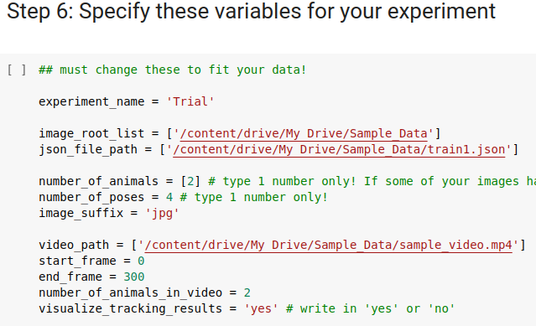
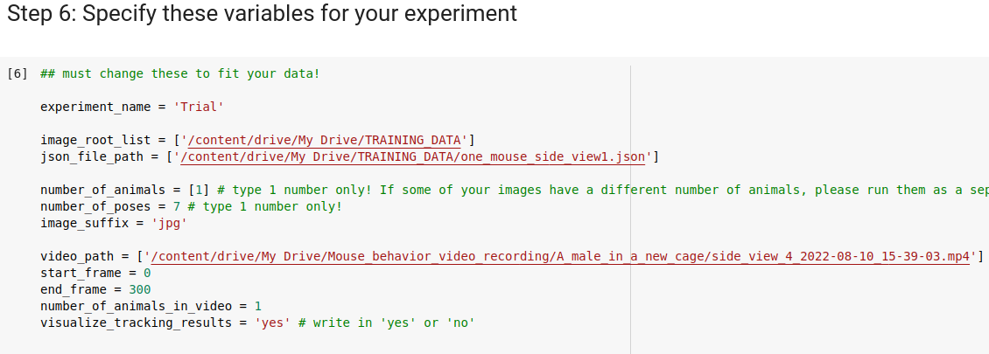
Modification of parameters and paths
Sample files
Our files

Slide 7
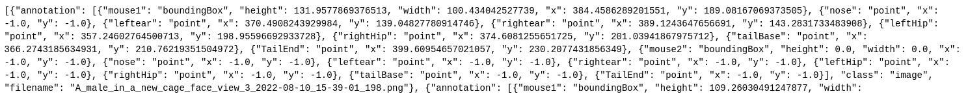
Different JSONs format

Slide 8
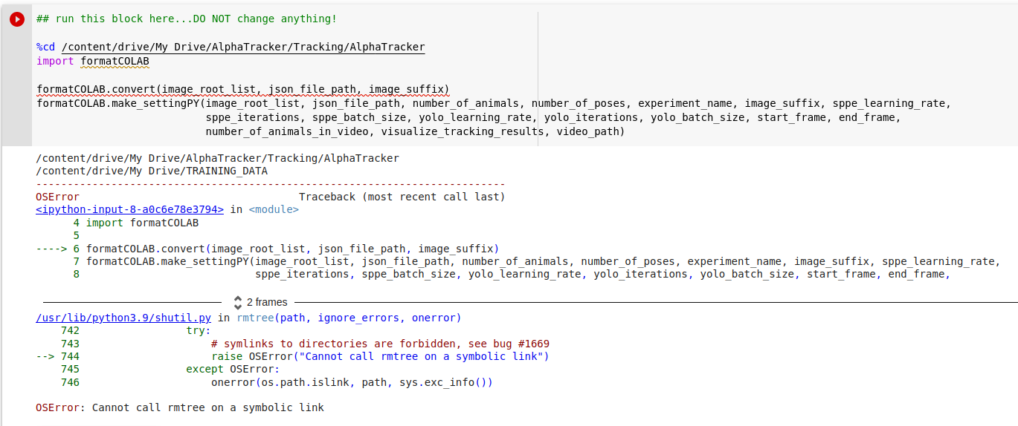
Unknown error

Slide 9
3. Visualization
Previous step:
Run server.py for the UI

Slide 10
QUESTIONS
Has Google Colab its own interface to visualize data?
How the output should look like?
Can you please show us how it should work or what are we supposed to get at the end?
How are we supposed to visualize the images with the annotations ? Is there a module in the project for visualization?

Slide 11
Task 3
4/7/2023

Slide 12
1. Data
Fixed some mistakes and revised the annotations with the visualization notebook

Slide 13
2. Training
Could not train with the new datasets.
No visualization when training with the demo datasets.

Slide 14
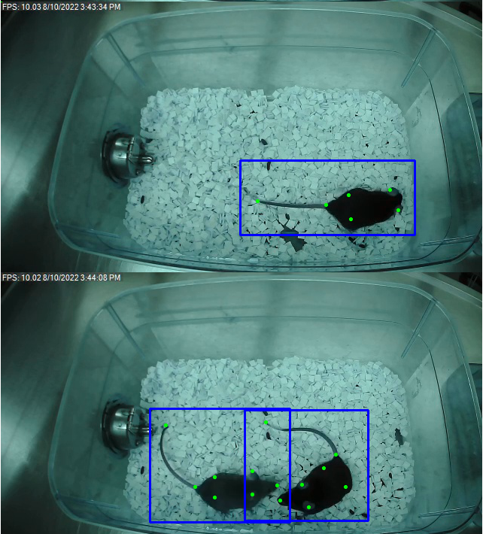
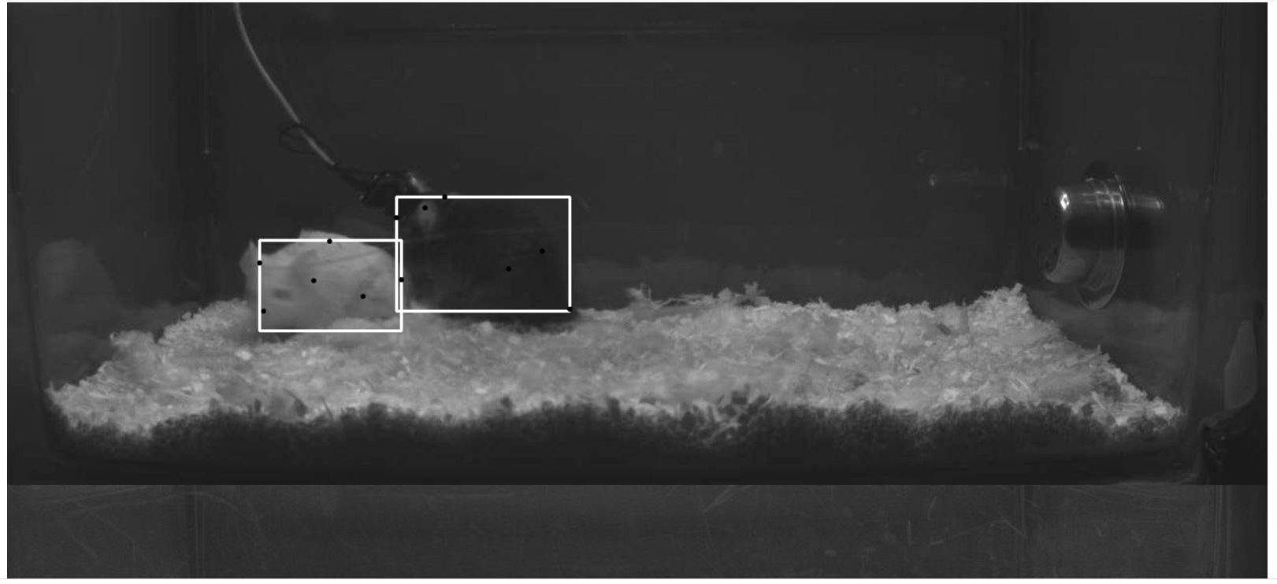
3. Visualization
Developed a python notebook for visualizing the annotations in the images.
It is a version of the visualization code that works with json files instead of csv files

Slide 15
Progress developed
Annotations: Carlos M
Training:
New Datasets: Guillermo
Demo: Carlos M
Visualization:
visualization notebook, Carlos M

Slide 16
Problems
Can’t train with new datasets, even adding directly the images to the directory.

Slide 17
